Slide 1



Daily Typing Do-Now
Open typing.com
Log into your account
Complete a 1 minute typing test
With the remaining 4 minutes
Work on a typing lesson
Play a typing game
Complete more typing tests

Slide 2
Do Now, Play 2048
Go to play2048.co
Try to get a high score in the game
Pay attention to the specific numbers in the game

Slide 3
Unit 2 - Binary Numbers!

Slide 4
Slides on CodeHS
Intro to Digital Information
Number Systems

Slide 5
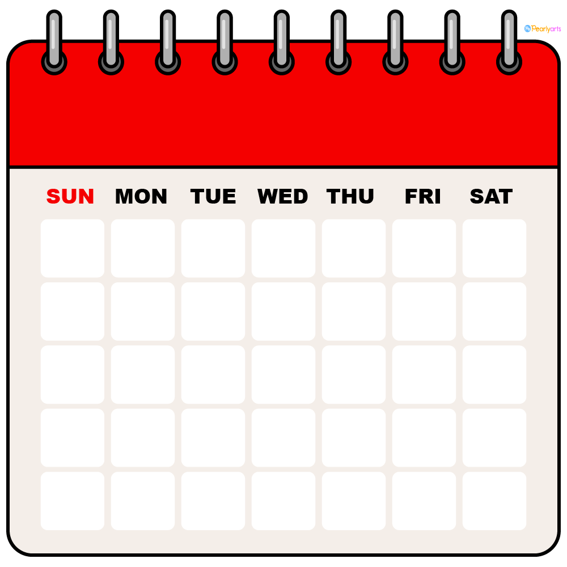
Schedule
Week 2
Monday - Transistors / History of Computing
Tuesday - Anatomy of a Computer
Wednesday - Binary Day 1
Thursday - Binary Day 2
Friday - Binary Competition
Week 3
Monday - Binary Quiz (Formative)

Slide 6
Binary Day 1

Slide 7
Binary Game
Find on Google Classroom or
https://tinyurl.com/mtvbinarygame
Raise your hand once you get 1000 points, and I will give P&P credit.

Slide 8
Binary Day 2
Binary Worksheet

Slide 9
Binary Day 3
Binary Competition

Slide 10
Competition Rules
You will be in teams with your new table
You will get a series of problems, you may divide the problems anyway you like as a team
You can work separately but must write down final answers on the half sheet provided
When you are finished bring up your paper
There will be 4 rounds
Scoring
Each correct answer: 1 point
First 100% accurate submission: 3 extra points

Slide 11

3 Minutes to Strategize
8 Questions Each Time
They will get progressively harder
6 minutes each
All answers must be
correct for full points
You may write anything
you want on scratch paper

Slide 12

Round 1 - Binary to Decimal
110₂
101₂
1100₂
1010₂
11 0001₂
10 1011₂
1000 1010₂
1011 1000₂

Slide 13
Round 2 - Decimal to Binary
6₁₀
9₁₀
24₁₀
31₁₀
44₁₀
55₁₀
93₁₀
121₁₀

Slide 14
Round 3 - Mixed
1010₂
33₁₀
1011₂
39₁₀
77₁₀
10 1001₂
255₁₀
1001 1101₂

Slide 15

Round 4 - Double Points Mixed
1010 0110₂
130₁₀
1000 0111₂
144₁₀
1011 0001₂
1001 1111₂
254₁₀
1111 1111₂

Slide 16
Day 4
Data Storage & Quiz

Slide 17
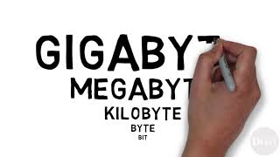

Slide 18

Digital Storage - Challenge Problems

Slide 19
Norms
Desks should be clear of everything except for a pencil
Any headphones, phone use, or other use of technology will be considered academic dishonesty
Any speaking during the test, will be considered academic dishonesty
When you have finished and your TEST IS TURNED IN, you may silently complete other work on your computer
Showing your work is optional but may result in partial credit

Slide 20

Quiz Timer

